Slide 1

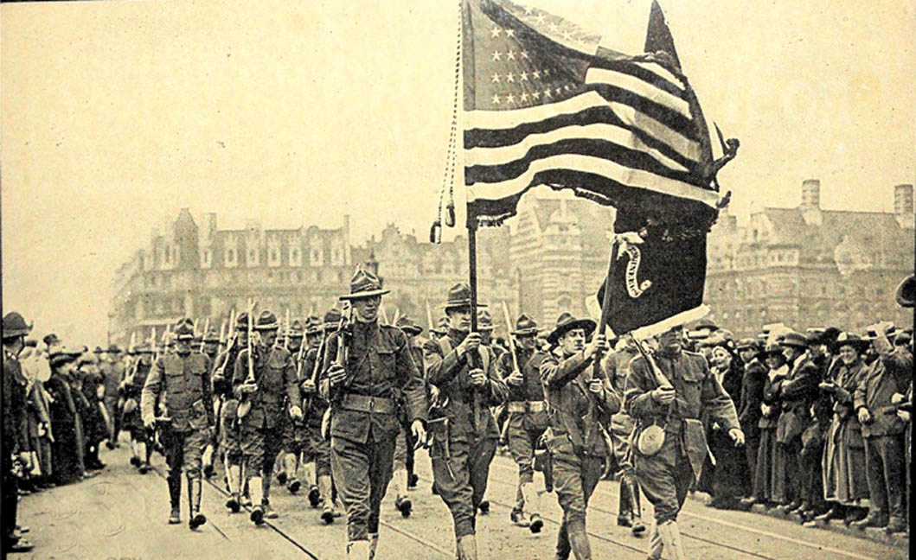
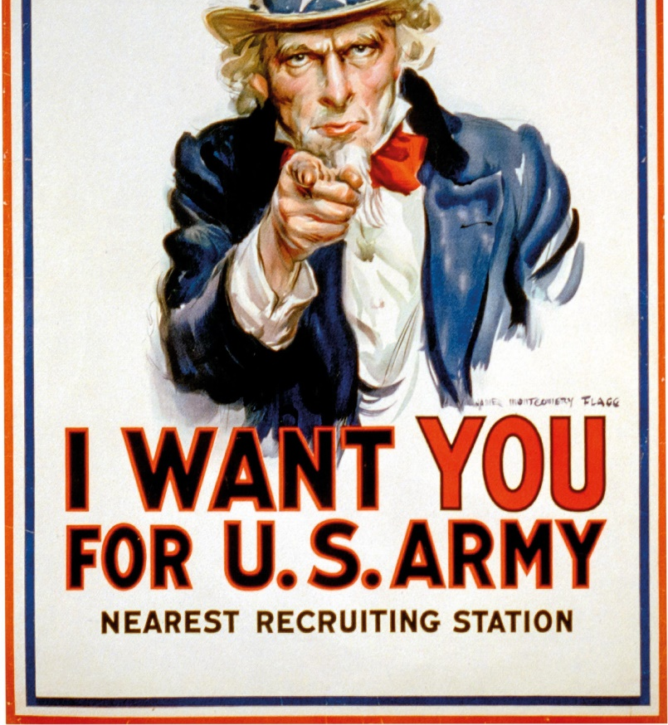
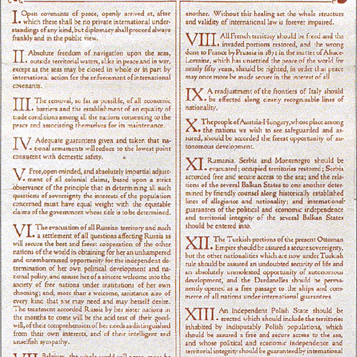
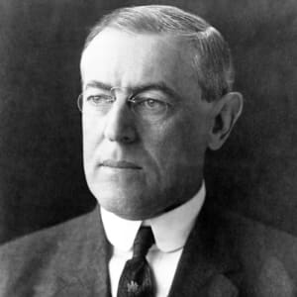
Woodrow Wilson and America’s involvement in World War I The Fourteen Points and the return to isolationism The impact of World War I on American capitalism (Industrialisation, Capitalism, Constitutional amendments: women voting, Immigration restriction)
Year 11 Modern History

Slide 2
Woodrow Wilson
Democratic President from 1912 to 1921.
Ended laissez-faire politics and believed in gov’s greater control over businesses.
New Freedom Program = series of legislative measures by which government intervened, for example, to investigate and regulate matters such as finances of large business corporations.

Slide 3
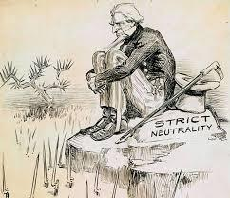
Woodrow Wilson and the First World War Why did America declare neutrality initially?
Woodrow Wilson President for duration of WW1.
WW1 began august 1914 but America remained neutral.
America lent money to allies and sold munitions and food to Britain and France – as German and British industries were disrupted by war, those in America took over and boomed, the average wage rose by 25 per cent.

Slide 4
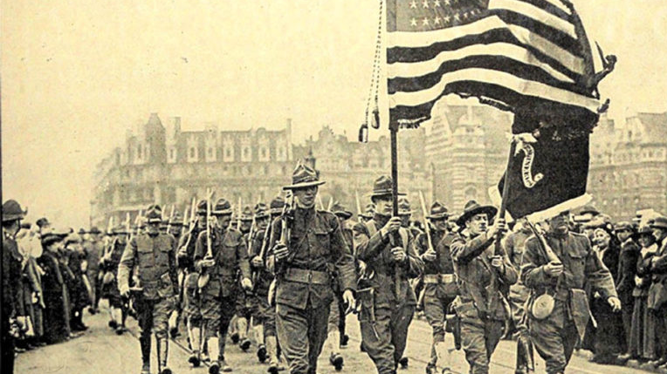

How did America become involved in WW1?
Sequence of events…
Public opinion turned negative against Germany with U-boat attacks in the Atlantic – sinking of British North Atlantic passenger liner ‘Lusitania’ May 1915 with 128 American on board.
Wilson personally supported Britain – democratic ties, cultural history.
German U-boats began attacking American ships transporting supplies to allies.
Zimmermann Telegram from German Foreign Minister to Mexico proposing that Mexico support Germany against USA.
America enters WW1 April 6th 1917.

Slide 5

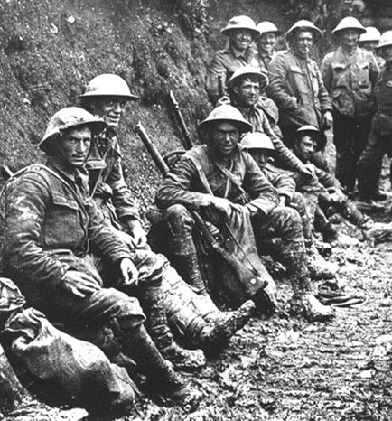
Course of War
Part 1 https://www.youtube.com/watch?v=_uk_6vfqwTA
Part 2 https://www.youtube.com/watch?v=Mun1dKkc_As
The US troops arrived just in time to turn the tide of the war in favour of the Allies.
Both sides were exhausted and running out of soldiers.
The influx of fresh troops helped to boost the morale of the Allies and played a major role in the defeat of the Germans.

Slide 6
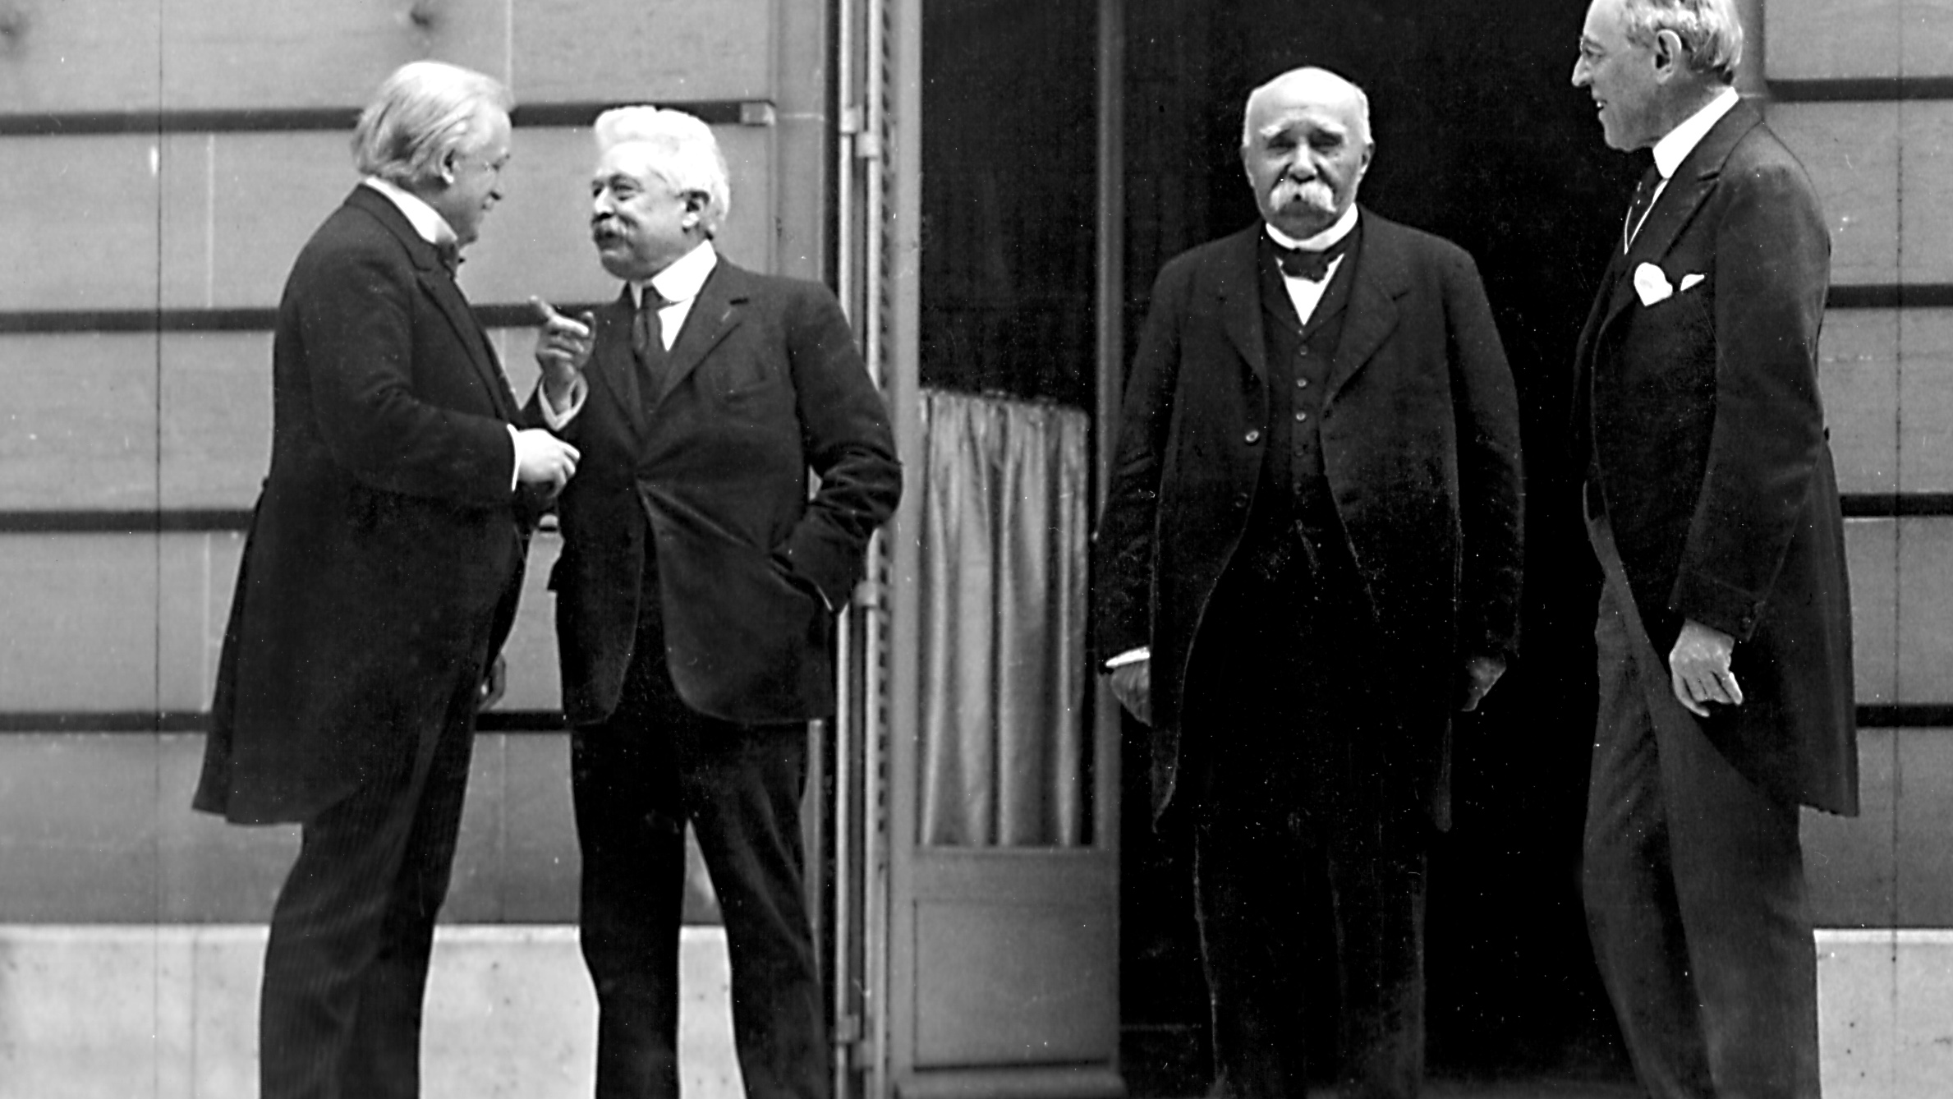
After War: The Fourteen Points
After Germany was defeated, President Wilson pushed for his Fourteen Points to be followed by the rest of Europe and the Allies.
Wilson wanted all of Europe to be able to recover quickly from the war, including Germany.
France and Britain disagreed and placed harsh reparations on Germany in the Treaty of Versailles.
Proposals issued on 8th January 1918 in form of
Fourteen Points.
There should be no more secret treaties
Absolute freedom of the seas at all times
Free trade between nations
All armaments to be reduced
The rights and opinions of people living in colonies to be considered when settling colonial claims
The Germans must withdraw from Russian territory
Belgium must be free and independent
France will regain the territory of Alsace-Lorraine (lost 1871)
The border between Austria and Italy to be readjusted (Italy’s favour)
The peoples of eastern Europe must have self-determination in their own independent nations
Romania, Serbia and Montenegro must be liberated and their territory guaranteed by international agreement
The people in the Turkish Empire must decide upon their own future (Turkey had fought on the side of Germany and Austria-Hungary)
An independent Polish state should be created.
An association of nations – the League of Nations – to be set up to settle all disputes between countries

Slide 7
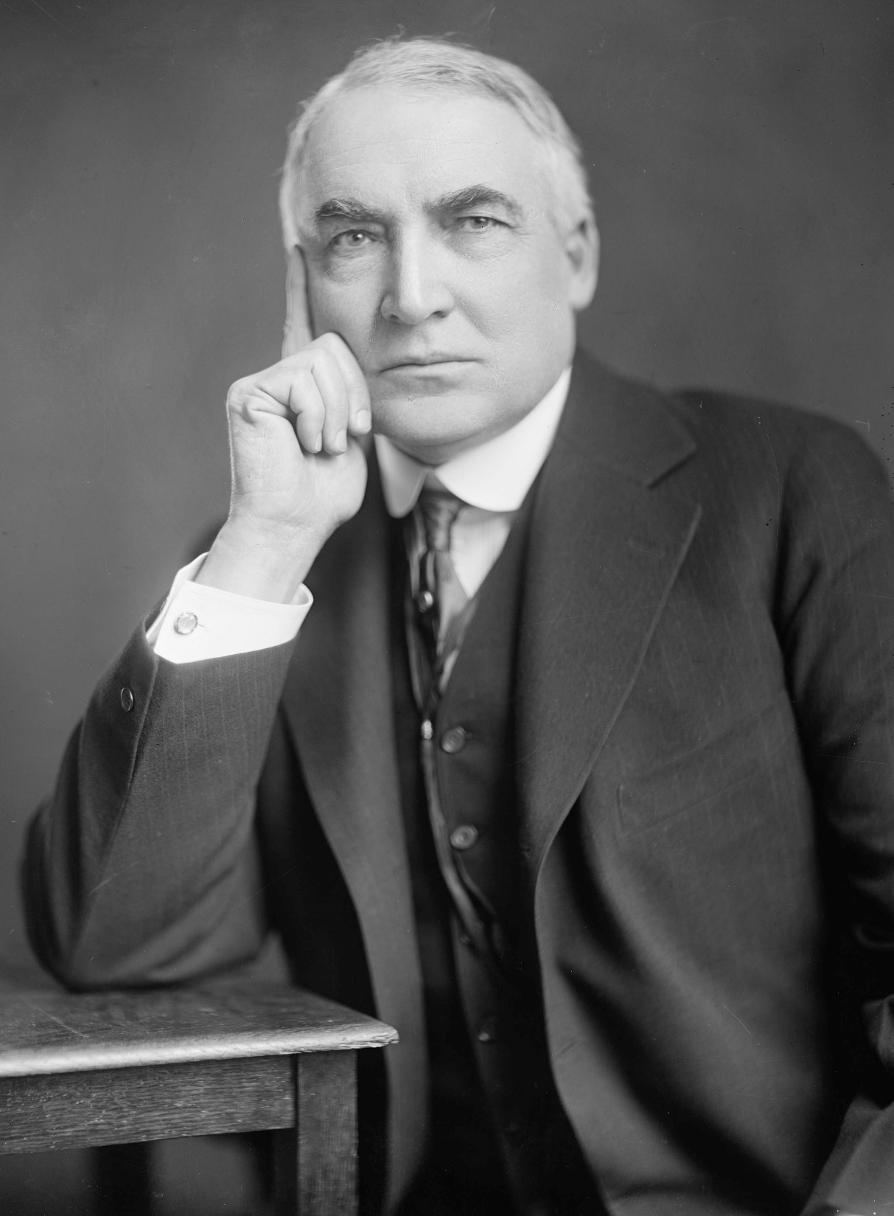
Return to isolationism
Isolationism: The political belief that a nation should stay out of the disputes and affairs of other nations.
The United States practiced a policy of isolationism until entering WW1.
Following end of WW1 Americans did not support Wilson’s Fourteen Points and wanted to stay out of international politics.
League of Nations rejected by Congress.
America returned to isolationist policies and ‘normalcy’ (Warren Harding).

Slide 8
The impact of World War I on American capitalism
Social
Conscription - Selective Services Act
Women became prominent in paid workforce
Suffragists believed their involvement in the war would guarantee them the right to vote
Wilson supported women’s suffrage
1920 Nineteenth Amendment gave women the right to vote
Negroes, Mexican-Americans, Chinese-Americans migrated to industrial cities to obtain jobs vacated by WASP soldiers.
Influenza epidemic disoriented Americans and killed estimated 675 000
Civil liberties severely diminished;
Committee of Public information censored news
Anti-espionage laws passed
‘Red Scare’ began, involving socialists, communists, labour organisers, anarchists, pacifists.

Slide 9
The impact of World War I on American capitalism
Economic
Increased government controls over economy through;
War Industries Board, Railways Administration & Food Administration
Labour force regulated through;
War Labour Board & Labour Policies Board
Increase in union membership
The US experienced economic boom owing to wartime armaments, fuel and food production.

Slide 10
The impact of World War I on American capitalism
Political
President was able to exercise wide-ranging emergency powers in his role as commander-in-chief of the military – what is the legacy of this?
Red Summer 1919 and 1920 – racial violence
Red Scare 1919 – 36 000 strikes, influence of communism
Palmer Raids November 1919 and January 1920
Sacco and Vanzetti
Many Americans considered the Democratic Party too ‘socialist’. As Wilson and his Party had led the US into WW1 without the support of the majority of Americans, the Fourteen Points was not popular.
In international terms, the USA became the largest economy in the world during WW1. This, and the fact that the US was on the winning side gave her international prestige.
Immigration Restriction Act
Immigration quotas introduced 1921
Immigration Act 1924 reduced number of immigrants

Slide 11
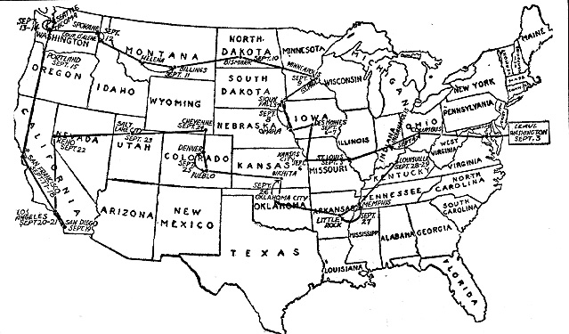
The impact of World War I on American capitalism
On the whole, Americans experienced increased regulation of their lives and the economy in which they worked.

Slide 12

Key questions Write a paragraph response to each of these questions practicing TEXR.
Why did the USA remain neutral when war broke out in Europe 1914?
What was Wilson’s vision for world peace after the First World War?
What impact did the war have on industrialisation? What did this lead to in future years?

